Slide 1
Red-Black Tree- Deletion

Slide 2
Red Black Tree- Deletion
To perform the operation, we first execute the deletion algorithm for binary search trees
Thus, the node which is deleted is the parent of an external node.
If node is red, it won't violate any property
If node is a leaf, it won't violate any property
Otherwise, if node is black and has a child, it will violate property 2, 3, and 4
For property 2, set the color of root to black after deletion

Slide 3
Red Black Tree- Deletion
To fix property 3 and 4:
From now on, let's call the deleted node to be z
If z's child x (which is the replacing node) is red, set x to black. Done!
If x is black, add another black to x, so that x will be a doubly black node, and property 3 and 4 are fixed. But property 1 is violated

Slide 4
Red Black Tree- Deletion
To fix property 1, we will consider if
x is a left child or right child
The color of x's sibling w is red or black
The colors of w's children
We consider x is a left child first, the other case can be done by symmetric operation

Slide 5
Red Black Tree- Deletion
There are 4 cases:
Case 1: w is red
Case 2: w is black, both w's children are black
Case 3: w is black, w's left child is red, w's right child is black
Case 4: w is black, w's right child is red

Slide 6
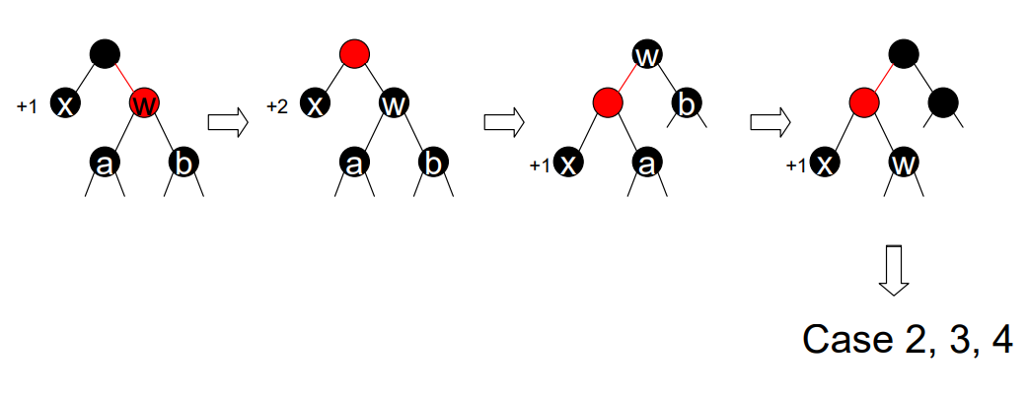
Red Black Tree - Deletion
Case 1: w is red

Slide 7
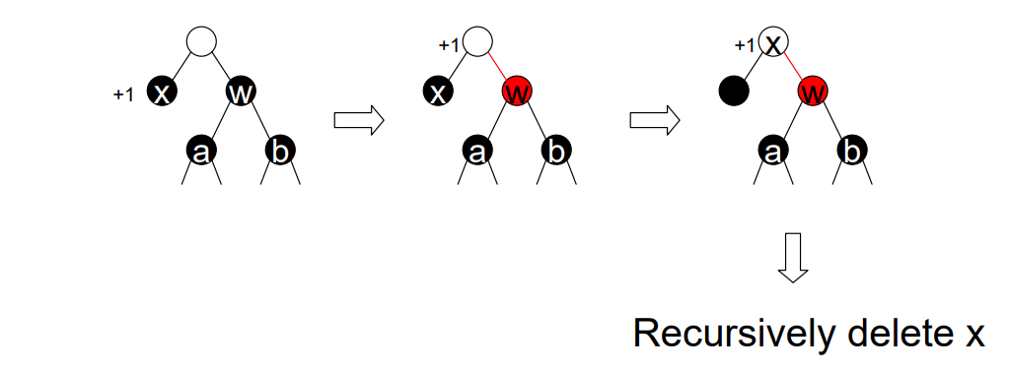
Red Black Tree - Deletion
Case 2: w is black, both w’s children are black

Slide 8
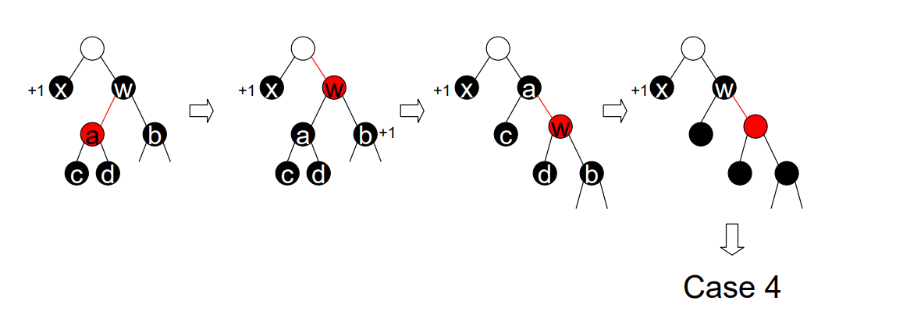
Red Black Tree - Deletion
Case 3: w is black, w’s left child is red, w’s right child is black

Slide 9
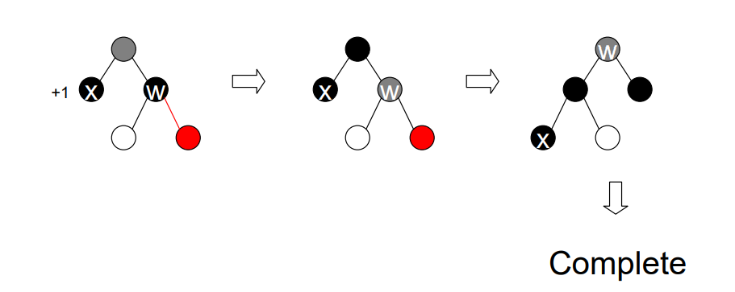
Red Black Tree - Deletion
Case 4: w is black, w’s right child is red

Slide 10
Red-Black Tree Deletion - Pseudocode
RB-Delete(T, z)
if z->left = null or z->right = null
then y ← z
else y ← TREE-SUCCESSOR(z)
if y->left ≠ null
then x ← y->left
else x ← y->right
x->p ← y->p
if y->p = null
then T->root ← x
else if y = y->p->left
then y->p->left ← x
else y->p->right ← x
if y ≠ z
then z->key ← y->key
copy y's data into z
if y->color = BLACK
then RB-DELETE-FIXUP(T, x)
return y

Slide 11
Red-Black Tree Deletion - Pseudocode
RB-DELETE-FIXUP(T, x)
while x ≠ T->root and x->color = BLACK
do if x = x->p->left
then w ← x->p->right
if w->color = RED
then w->color ← BLACK Case 1
x->p->color ← RED Case 1
LEFT-ROTATE(T, x->p) Case 1
w ← x->p->right Case 1
if w->left->color = BLACK and w->right->color = BLACK
then w->color ← RED Case 2
x ← x->p Case 2
else if w->right->color = BLACK
then w->left->color ← BLACK Case 3
w->color ← RED Case 3
RIGHT-ROTATE(T, w) Case 3
w ← x->p->right Case 3
w->color ← x->p->color Case 4
x->p->color ← BLACK Case 4
w->right->color ← BLACK Case 4
LEFT-ROTATE(T, x->p) Case 4
x ← T->root Case 4
else (same as then clause with "right" and "left" exchanged)
x->color ← BLACK

Slide 12
Red Black Tree – Deletion Summary
In all cases, except 2, deletion can be completed by a simple rotation/ recoloring.
In case 2, the height of the subtree reduces and so we need to proceed up the tree
Complexity- O(log n)
If we proceed up the tree, we only need to recolor/rotate.

Slide 13
Red-Black Trees to 2-4 Trees
Any red-black tree can be converted into a 2-4 tree
Take a black node and its red children (at most 2) and combine them into one node of a 2-4 tree.
Each node thus formed has at least 1 and at most 3 keys
Since black depth of all external nodes is the same, in the resulting 2-4 tree all the external nodes will be at the same level.

Slide 14
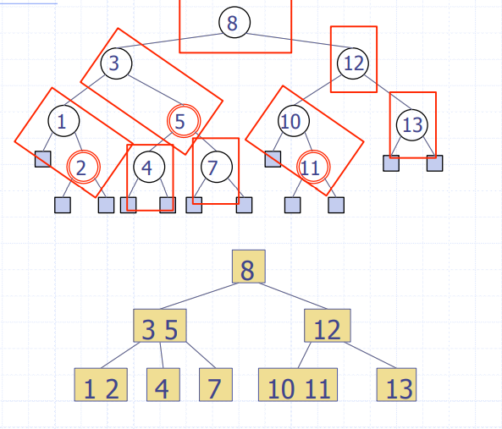
Red-Black Tree to 2-4 Tree - Example

Slide 15
2-4 Trees to Red-Black Trees
Any 2-4 tree can be converted into a red-black tree
We replace a node of the 2-4 tree with one black node and 0/1/2 red nodes which are children of the black node.
The height of 2-4 tree is the black depth of the red-black tree created.
Every red node has a black child.

Slide 16
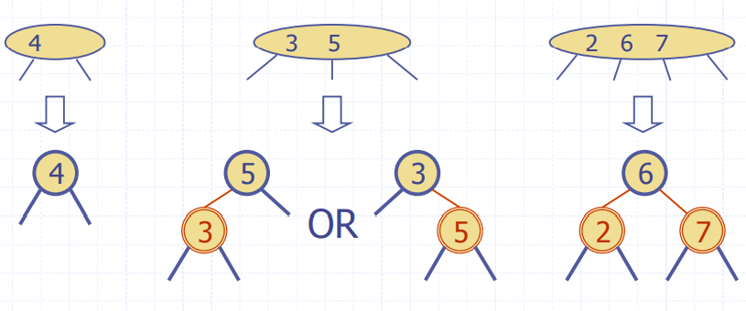
2-4 Tree to Red-Black Trees

Slide 17
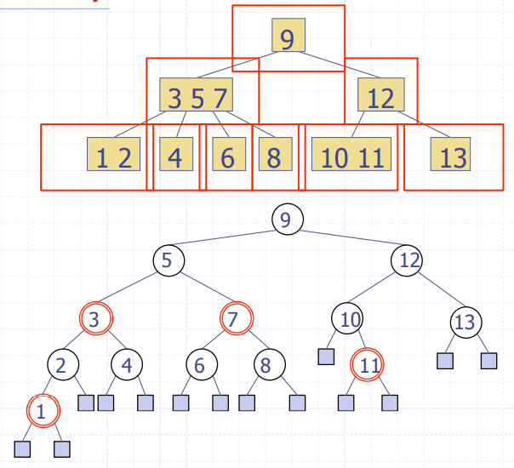
2-4 Trees to Red-Black Trees - Example

